Slide 1
Pathways Learning Experience
District 96
Club Management Curriculum
Facilitator(s): Maureen McBeath, Janice Parkinson
Date: October 22, 2018
Notes:
Red text
Slides with information, ideas and suggestions. These are all hidden and can be removed before completion of the material
“Instructor’s Tips” for module designers also appear in speakers notes. These can be removed or replaced by notes to instructors on the particular slide if needed
The purpose of the template is to follow instructional design principles and promote consistency across the D96 curriculum
Black text
This provides examples and descriptions that module designers will modify as they create their material
Materials Needed:
Checklist of facilities required for the course
Location and time
Identification of Screen/projector or other needs
Checklist of administrative logistics prior to the course
Participants attending and their email contacts
Prework to be delivered prior to the course (and how far in advance)
Checklist of any materials needed in advance of the course
Printed Student Worksheet
Printed Evaluations (possibly envelopes for anonymity)
Materials required for any activities

Slide 2

Select a Path
Notes:
This is one of _____________ modules designed to help Toastmasters members with the Pathways learning experience. Members may be new or older members transitioning from the Traditional program. Members may be club officers, base camp managers, mentors or a club member.

Slide 3
Agenda
Introduction
The Quick and Easy way
The Long way
Q & A

Slide 4
Introduction
Who are we?
A Toastmaster member before/after March 20, 2018?
A club officer, base camp manager, mentor?
A club member?
What are we talking about?
Which path should I take?
How do I help someone else pick a path?
What’s the difference between the different paths?
Notes:
<Instructor’s Tips>
Clarify the assumed target audience, based on curriculum personas
Introduce the topic with a compelling story or bold statement to generate immediate interest
Adults need a clear statement of the personal benefit to them
I think the topic here is to answer questions, but you could also have a story about a person/club who went from frustration to success
This is you answer WIIFM (what’s in it for me?) for each audience
Members may be new or older members transitioning from the Traditional program. Members may be club officers, base camp managers, mentors or a club member.

Slide 5
Learning Objectives
By the end of this module, you should be able to:
Select an education path
Help a fellow member select a path
Notes:
Instructor’s Tips
Keep the objectives to a minimum for clarity
Write objectives with a measurable verb (eg. Demonstrate/describe instead of understand/know). Avoid words like ‘effective’ that are open to interpretation
Define evaluation criteria for each objective before you create the module to focus the material to maintain focus throughout
Consider: what behavior change you are seeking by the end of the module?
Expert facilitators: relate to comments/experiences from learners described in the prework
Consider the performance objectives, too: what will people be able to perform when they leave the session
Instructor guidance on module material
Write/speak with supportive/inspiring language to help people believe they can succeed (focus on what they can do, not what they can’t)
Early on, grab attention or provoke to and motivate interest (or get people involved in a task)
Practicing is critical to learning—modules need activities, feedback (WWW/EBI), review, assessment.
Share your experiences/stories and draw in those of learners to make it relevant (adults learn better if they can tie ideas to past experiences)
Content should support learning objectives and nothing else, periodically refer back to the objectives
Don’t make assumptions about how people will feel/respond (eg. ‘easy’)
Use plain language define any specialized terms (maybe include a glossary)
Examples (for illustration), analogies (for clarity) and stories (for rapport and connection) are very effective. Use several around a single situation throughout a module to reinforce material

Slide 6
Questions to be answered today
How many levels in a Path?
How many Paths are there?
Where is the “ Pathways Paths and Projects” catalog on the District 96 website?
Do you have to do Pathways online?
How much does a Path cost?
How many projects are there in Pathways?
Which path(s) contain the “Managing Time” project?
______
______
Notes:
Instructor’s Tips
This is a set of questions this module will answer - review with participants and have them add any questions they have on a topic.
The goal is to engage participants, have them personalize material to their situation, and for the instructor to learn about the participants
You could include an activity to lead into the course here
The survey should impact the module’s focus for each audience
This discussion will lead into the objectives, which come next
We need some sample pre-work/survey templates

Slide 7
The Quick and Easy Way
Take the Assessment
Pick one of the recommendations
Get started ...
Notes:
Members who have joined toastmasters after March 20, 2018 will receive an email pointing them to the assessment and select a path. All members March 20, 2018 received an email from TI doing the same.

Slide 8

Login to toastmasters.org

Slide 9
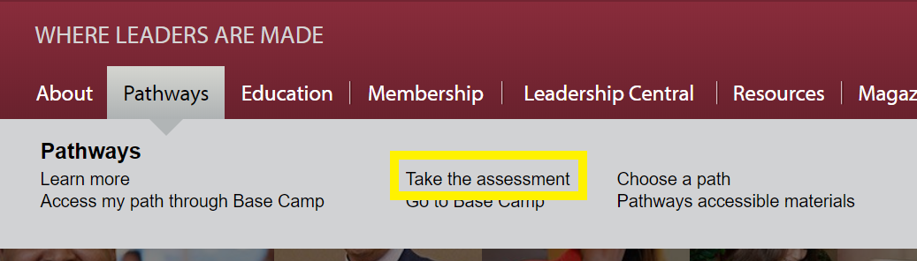
Take the Assessment

Slide 10
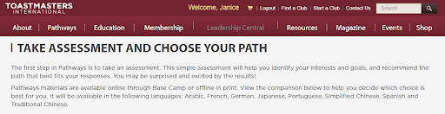
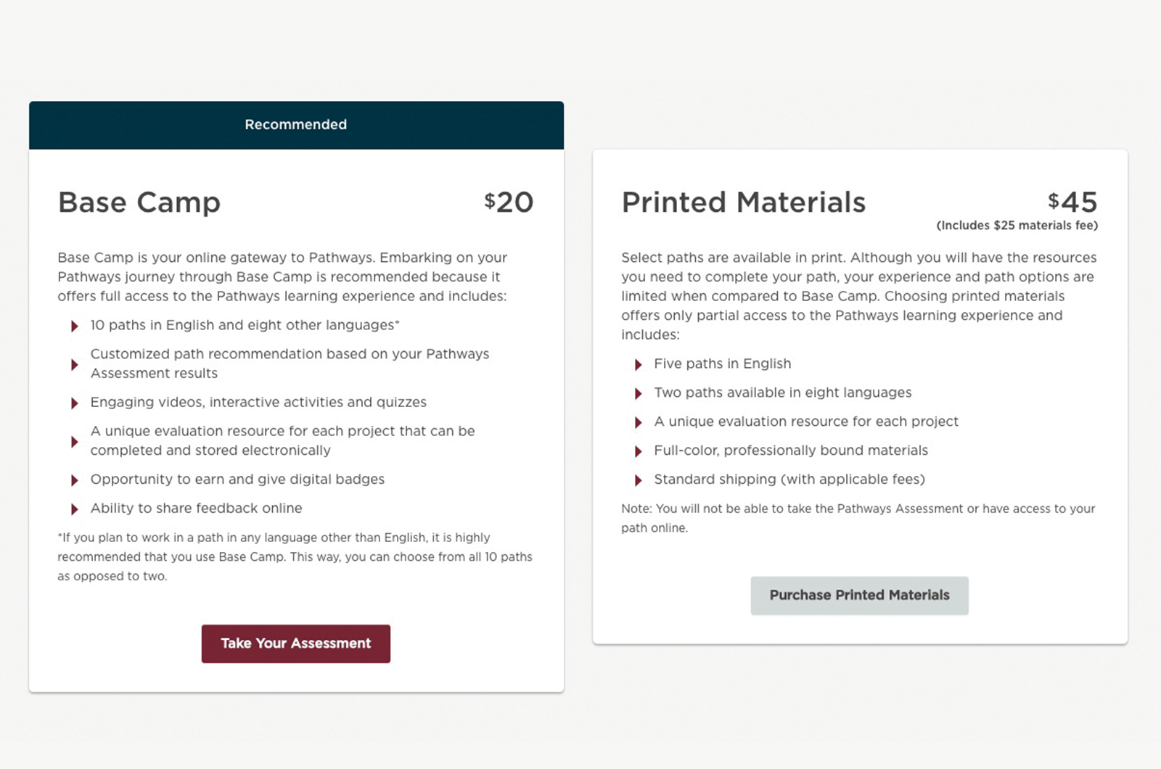
Take the Assessment
Notes:
This is the time to talk about the print option - or taking the online option and printing the projects.

Slide 11
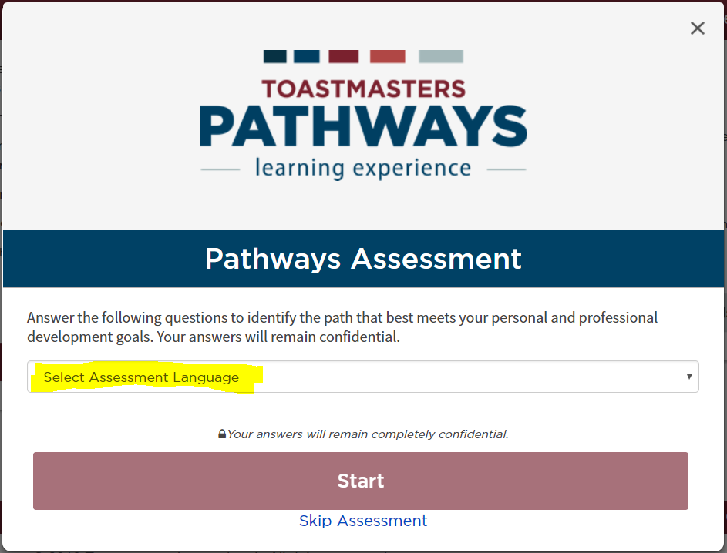
Take the Assessment
Notes:
Takes about 5 to 10 minutes. Answer the questions honestly.

Slide 12
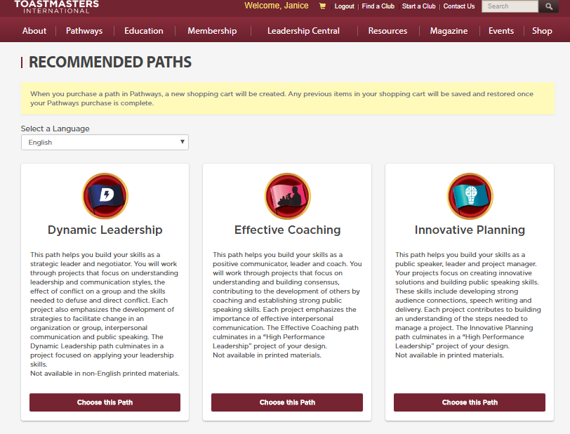
The Quick and Easy Way
Take the Assessment
Pick one of the recommendations
Get started ...
Notes:
If a description of the path seems interesting - pick it. If none of the descriptions appeal then, make a note of the three recommendations and take a look at the “Long Way”

Slide 13
The Quick and Easy Way
Take the Assessment
Pick one of the recommendations
Get started ...
Notes:
After a path is selected - an email will be sent to you that will allow you to access base camp. You may also be taken directly to the Base Camp landing page

Slide 14
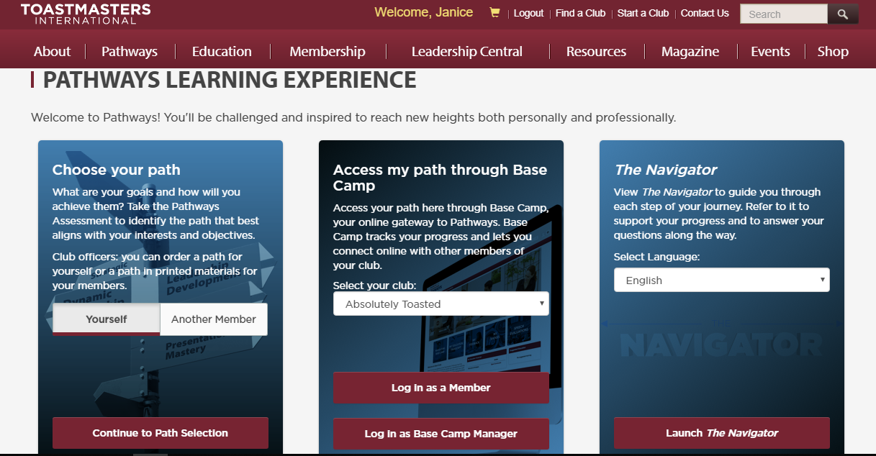
Login to Base Camp
Take the Assessment
Pick one of the recommendations
Get started ...
Notes:
The end. If you find the path not to your likely - you have 30 days to contact TI and request an exchange.
Using Base Camp to be continued in the “Complete Level 1” module.

Slide 15
The Long Way
Learn about the different paths
Figure out what the differences are
Determine which projects you REALLY want to do
Take the assessment - skip the questions and pick your path
Get Started
Notes:
Instructor’s Tips
This is a set of questions this module will answer - review with participants and have them add any questions they have on a topic.
The goal is to engage participants, have them personalize material to their situation, and for the instructor to learn about the participants
You could include an activity to lead into the course here
The survey should impact the module’s focus for each audience
This discussion will lead into the objectives, which come next
We need some sample pre-work/survey templates

Slide 16
The Long Way
Learn about the different paths
Figure out what the differences are
Determine which projects you REALLY want to do
Take the assessment - skip the questions and pick your path
Get Started
Notes:
Instructor’s Tips
This is a set of questions this module will answer - review with participants and have them add any questions they have on a topic.
The goal is to engage participants, have them personalize material to their situation, and for the instructor to learn about the participants
You could include an activity to lead into the course here
The survey should impact the module’s focus for each audience
This discussion will lead into the objectives, which come next
We need some sample pre-work/survey templates

Slide 17










Ten Paths Available
Dynamic Leadership
Effective Coaching
Innovative Planning
Leadership Development
Motivational Strategies
Persuasive Influence
Presentation Mastery
Strategic Relationships
Team Collaboration
Visionary Communication
Notes:
Currently 10 different paths available to focus your education. More information available on district 96 website.

Slide 18





Five Levels Each
Mostly Communications
Communications & Leadership
Notes:
Each path consists of 5 levels, that progressively build on skills learnt in an earlier level. Each level must be completed before accessing the next level.

Slide 19
Level One: Four speeches, one evaluation
Ice Breaker (4 – 6 min)
Introduce yourself (Optional, share why you joined TM)
Evaluation and Feedback part 1: Speech (5 – 7 min)
Deliver a speech on any topic
Evaluation and Feedback part 2: Speech (5 – 7 min)
Repeat the last speech, incorporating evaluation feedback
Evaluation and Feedback part 3: Evaluation (2 – 3 min)
Evaluate a speech – a member will evaluate your evaluation
Researching and Presenting (5 – 7 min)
Deliver a speech using research and sources
Notes:
This level is the same for every path - so it doesn’t factor into deciding which path

Slide 20
The Long Way
Learn about the different paths
Figure out what the differences are
Determine which projects you REALLY want to do
Take the assessment - skip the questions and pick your path
Get Started
Notes:
Look at some of the resources and start figuring out what the differences between the paths are

Slide 21
Level Two : Three speeches
Introduction to Toastmaster Mentoring (5 – 7 min)
Deliver a speech about when you were a protege
The same for all paths
Understanding your Communication or Leadership Style (5 – 7 min)
Some paths examine Communication styles, others examine Leadership styles
Path Specific Project
Managing Time and Cross-Cultural Understanding are only available in one path
Notes:
Level 2 - mostly the same for all paths. The Path Specific project may appear as an elective in a different path. There are a few projects here at level 2 which are only available in one path.
http://d4tm.org/index.php/pathways/paths-and-projects.html - will explore this in the following activity which is to find the path for “Managing Time”
Bonus question will be - “Cross cultural Understanding” project is only available in the strategic relations path.

Slide 22
Find the path that contains the “Managing Time Project”
Purpose | Learn how to learn more about different paths
Process | Describe what participants need to do in detail: Find the District 4 website Examine the paths and projects Find the level 2 Managing time Project
Product | What was the path?
Post-activity debrief | Use this tool to find out more details about the different paths and projects
Notes:
Instructor Tips
Activities should be relevant to the objectives and material just presented, and could include exercises, case studies, discussions and games
Participants should practice a behavior to support learning
Participants should SUCCEED in the end—and debrief what happened
Always ask “what can I clarify?” before starting the activity

Slide 23
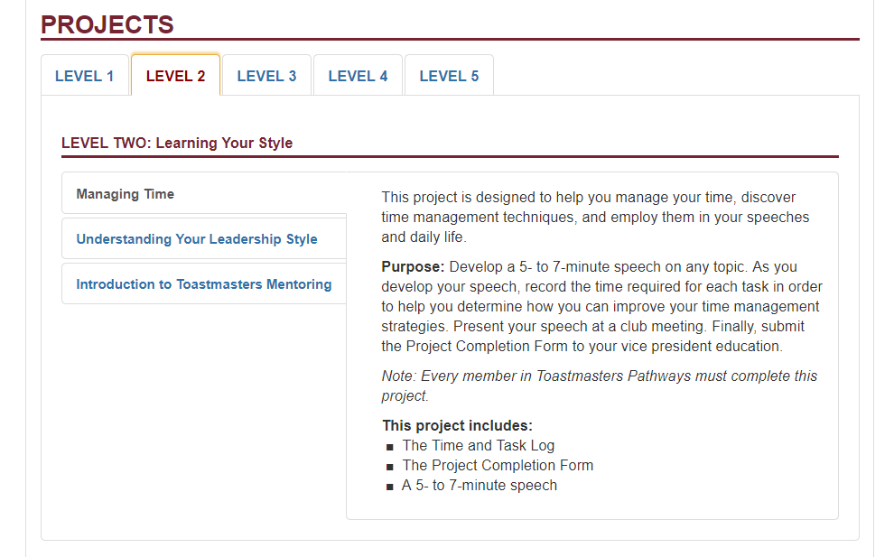
d4tm.org/index.php/pathways/paths-and-projects.html
Notes:
Instructor Tips
Activities should be relevant to the objectives and material just presented, and could include exercises, case studies, discussions and games
Participants should practice a behavior to support learning
Participants should SUCCEED in the end—and debrief what happened
Always ask “what can I clarify?” before starting the activity

Slide 24
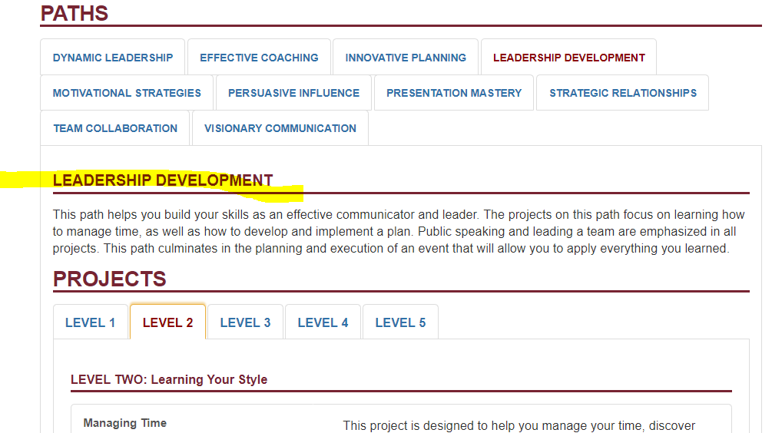
And the answer is….
Notes:
And the answer to the question is Leadership Development path contains the Manage Time project. Bonus - Cross Cultural Understanding is only in Strategic Relationships

Slide 25
Level Three: Three Projects
Required Project with a speech (5 – 7 min)
Mostly unique to the specific path
Is this a project your REALLY want to do?
Elective Project 1 with a speech (5-7 min)
Mostly available in all paths
Elective Project 2 with a speech (5-7 min)
Mostly available in all paths
Notes:
Use the District 4 site to explore Level 3 projects.

Slide 26
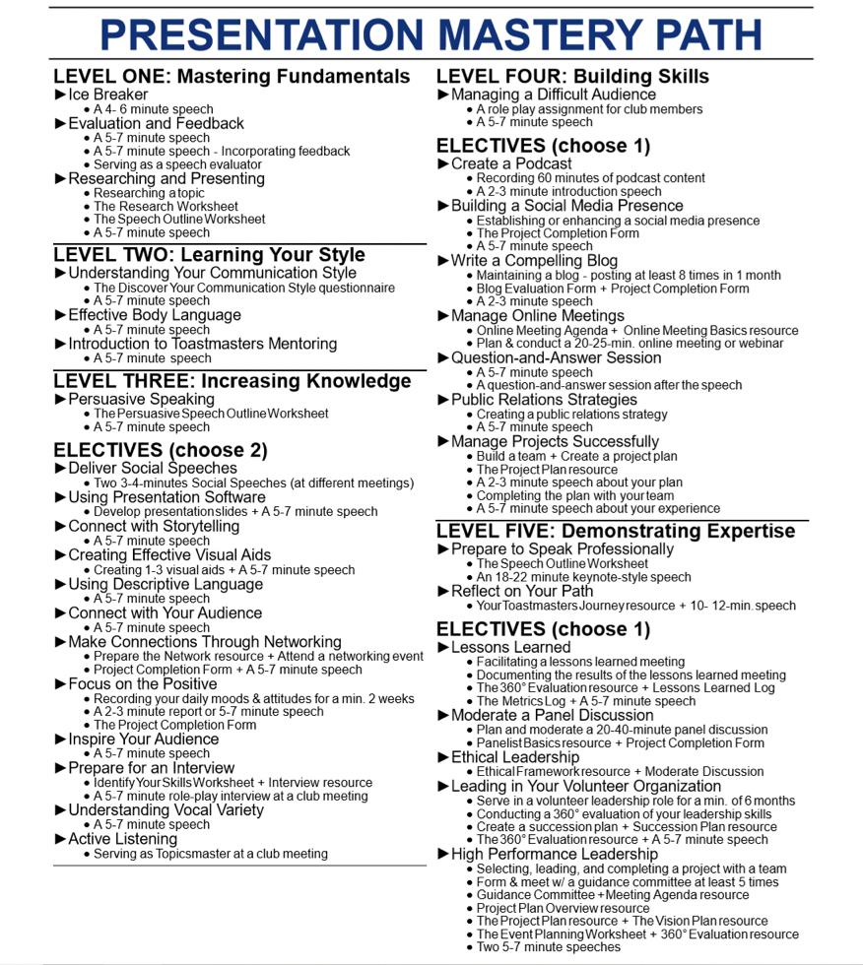
Unique project
Electives are similar across all 10 Paths

Slide 27
Level Four: Two Projects
Required Project with one or two speeches
Projects only available in one path
Manage Change
Improvement through Positive Coaching
Leading your Team
Communicate Change
Motivate Others
Elective Project with a speech
Mostly available in all paths
Notes:
Use the District 4 site to explore Level 4 projects. The projects include work (maybe months leading a team…) and then a speech. If you want to do one of the five listed projects - you have found your path.

Slide 28
Level Five: Three Projects
Required Project
Projects only available in one path
Manage Successful Events
Team Building
Develop your Vision
Elective Project
Mostly available in all paths
Reflect on your path with a speech (10-12) minute
Required in all paths
Notes:
Use the District 4 site to explore Level 5 projects. The projects include work (maybe months leading a team…) and then a speech. If you want to do one of the three listed projects - you have found your path.

Slide 29
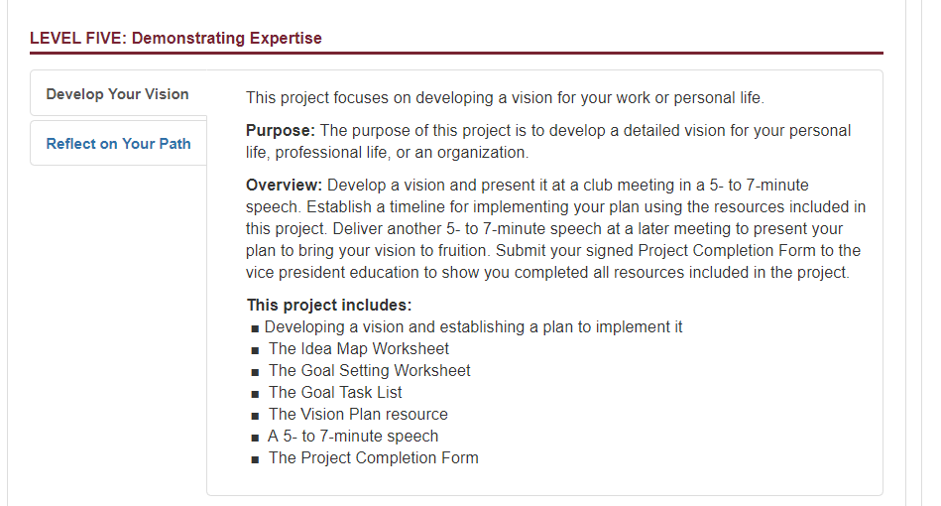
The Long Way
Learn about the different paths
Figure out what the differences are
Determine which projects you REALLY want to do
Take the assessment - skip the questions and pick your path
Get Started
Notes:
Look at the resources and look at the detailed project description

Slide 30
The Long Way
Learn about the different paths
Figure out what the differences are
Determine which projects you REALLY want to do
Take the assessment - skip the questions and pick your path
Get Started
Notes:
Look at the resources and look at the detailed project description

Slide 31
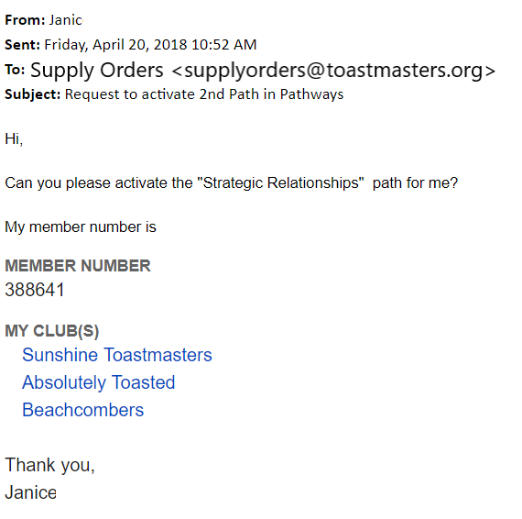
A Second Path is free
For people who were members of two or more clubs before March 20, 2018
Send an email to supplyorders@toastmasters.org
Notes:
This slide doesn’t apply to a new club

Slide 32
Review of Objectives
By the end of this module, you should be able to
Select an education path
Help a fellow member select a path
Short and Easy way
Long way
Notes:
Instructor Tips
Review the objectives and summarize key points to remember as they relate to the objectives (use a separate summary slide if it’s helpful)
Ask participants to summarize in their own words, trying to assess what they learning and what some of them personally gained from it

Slide 33
“I will” Statements
Write one (or more) specific actions you will take based on the material
Describe the benefit you or others will receive
Example :
I will talk to Joe about picking a path so that he can feel part of the new education program
Notes:
Instructor Tips
The goal of a module is to change behavior, one way to support this is to ask participants to commit to doing that
The participants must each define their own behavior (not the instructor)
You can choose whether or not to ask if people want to state them publicly (or say them to others in groups, maybe with accountability)
I find this effective, you can decide whether to include it, the idea is to get people to individually choose to commit to some action (you can write a couple of examples, but they need to write their own)

Slide 34
Additional References
You can find more information at the following links:
https://www.toastmasters.org/pathways-overview
http://d4tm.org/index.php/pathways/paths-and-projects.html
https://d96toastmasters.ca/pathways/paths-levels-projects
https://d96toastmasters.ca/resources/member/pathways-resources
Notes:
Instructor Tips
Provide a list of additional resources on the material: (eg. Books and web links) so participants can expand their knowledge

Slide 35
Evaluations
We want feedback on
WWW—what went well…
EBI—even better if…
Please take a few minutes to fill out the survey
Notes:
Instructor Tips
Use the evaluation to assess the material, delivery and participant learning
We hope to harvest and modify existing evaluation material for consistency, and provide guidance to instructors
We still need some sample evaluation templates for consistency

